Slide 1
Java Programming – Data Types
Notes:
2 - Describe and communicate hazards associated with this lesson
Health & Safety
Check trailing cables
Identify any visible hazards
Store student bags safely
Enforce no drinking rule next to electrical equipment
No mobile phone use
Equality & Diversity
Identify learners with specific needs
Provide all learners with same level of support where appropriate.
Safeguarding
Every Child Matters and college procedures
Ensure all learners have consent forms in case of photo / video work

Slide 2
This Lesson we will be…
Identifying the different data types used in Java
Exploring the purpose of the various data types.
Developing simple Java applications.
Notes:
2
Agree the Learning Outcomes
Including LO for functional skills development
LO for ELB, employment or enterprise skills development
Formative assessment strategies to be used in this session:
Q&A direct and volunteer
Peer assessment
Observation
Resources:
Computers
Whiteboard
PowerPoint
Internet
Eclipse Mars IDE
Embedding of literacy and numeracy development:
Select and use different types of texts to obtain and utilise relevant information;
Read and summarise, succinctly, information/ideas from different sources;
Identify the purposes of texts and comment on how meaning is conveyed;
Detect point of view, implicit meaning and/or bias;
Learning Outcomes for Effective Learner Behaviours, Employment or Enterprise Skills Development
Attitudes – Identify the correct attitudes
Skills – Apply the necessary skills
Knowledge – Use the knowledge gained
Introduction (Tutor)
Discuss Learning outcomes
Question students understanding
Consider groupings
Introduction (student)
Discuss Learning outcomes
Listen and ask questions
Volunteer answers to questions

Slide 3

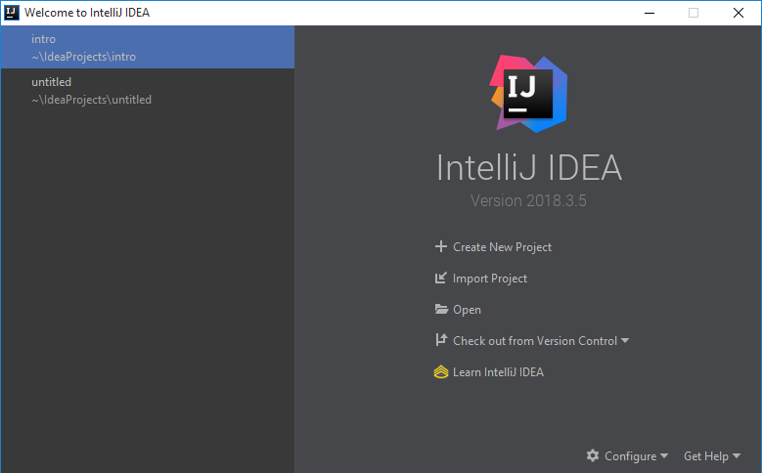
IntelliJ IDEA
Notes:
Teaching Strategies:
Exposition
Observation
Student Activities:
Listen
Make notes
Provide responses
Open the software
Ask Questions
Ongoing Assessment for Learning
Direct Questions
Students Discussion
Observations
Notes:
Learners make notes

Slide 4
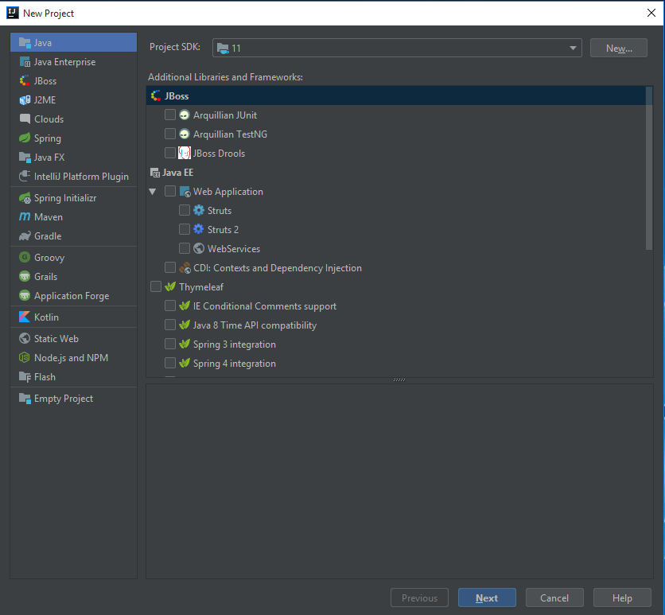
IntelliJ IDEA
Select ‘Create New Project’.

Slide 5
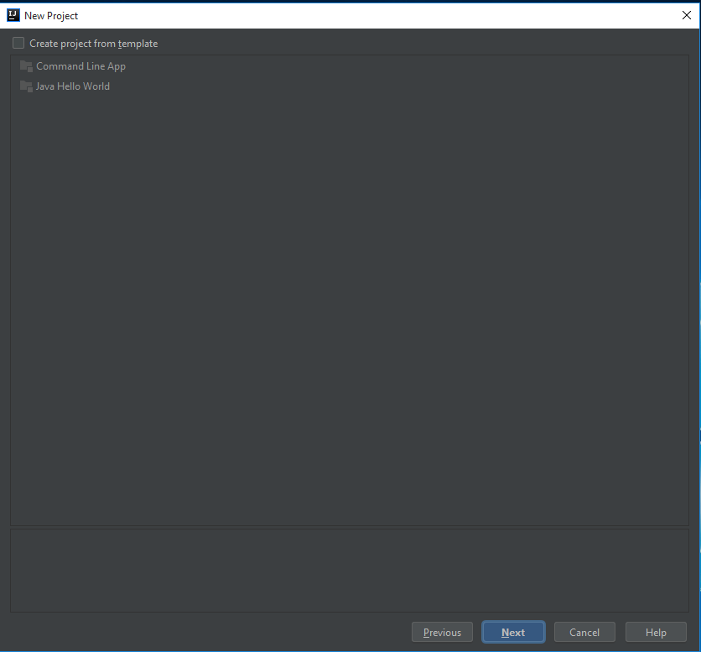
IntelliJ IDEA
Click Next and skip this step.

Slide 6
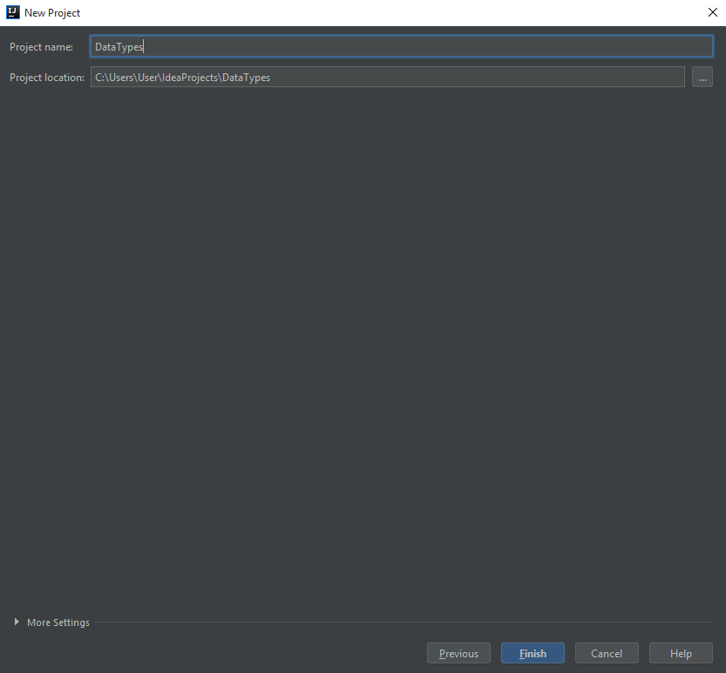
IntelliJ IDEA
Name your project ‘dataTypes’.
Select Finish.

Slide 7
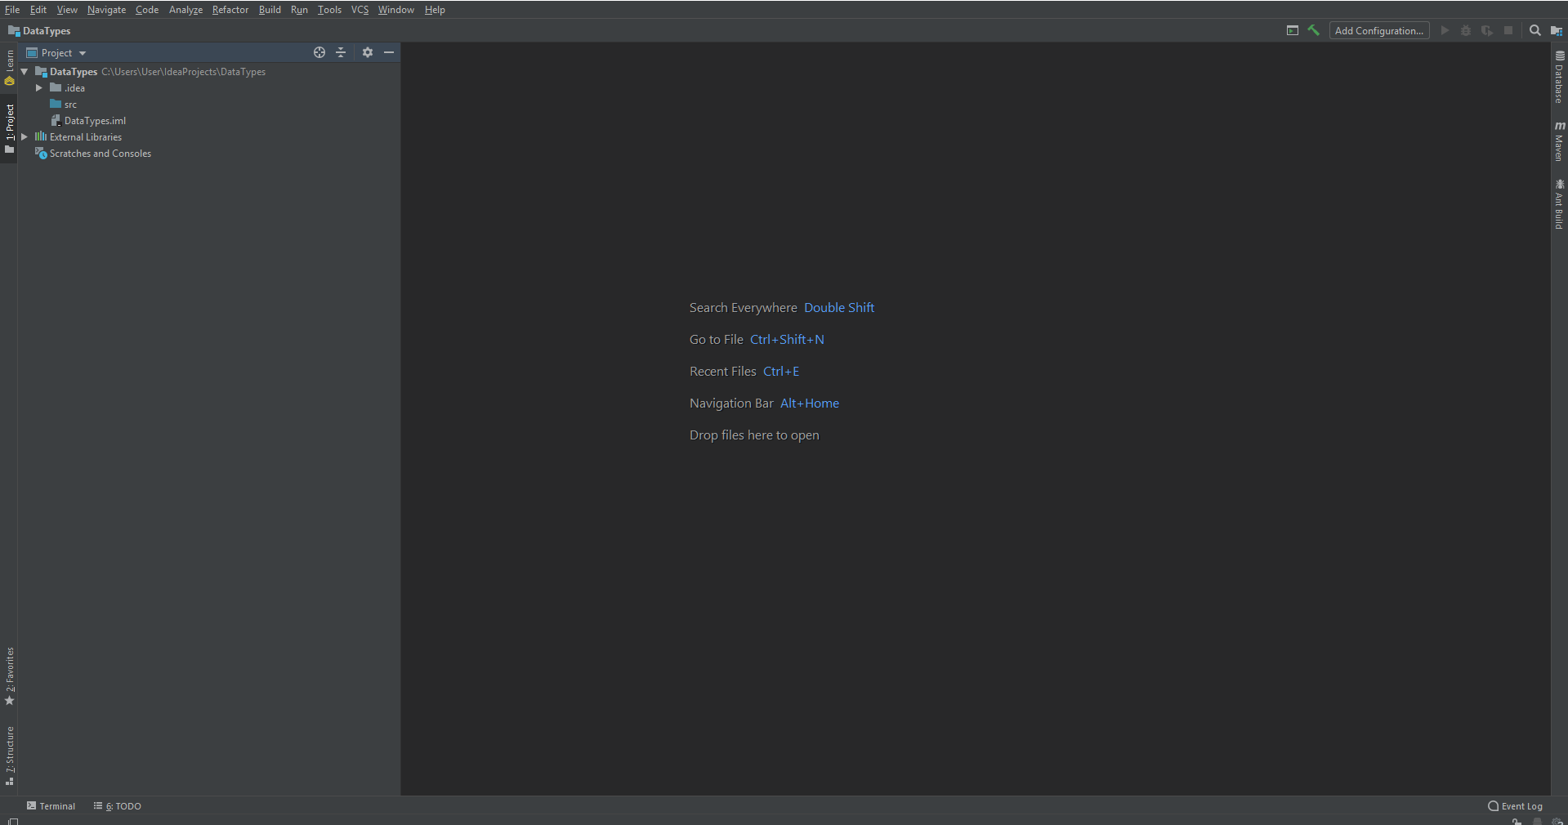

Slide 8

Coding Standards
When writing code, it is important that you follow good coding practices. Doing so will help you create clean and readable code that will not only be easier for others to understand, but also yourself.
camelCase – Camel case is a way of writing combined words that helps to improve their readability. thisIsEasierToRead than thisiseasiertoread.
Project names, class names, variable names and method names should all use camel case.
Packages do NOT use camel case.
*Shrug*
Variable and Method names
It is important that you give variables and methods meaningful names, this will make your life infinitely easier later on when you start creating larger programs.
The exception to this is for ‘throwaway’ variables e.g.

Slide 9
Data Types
Primitive Data Types
Integer
Double
Boolean
Character
Byte
Short
Long
The most common data types used in Java are ‘primitive’ data types.
Why are they called primitive?
Because they have no implementation.
There are also classes for each data type that can be utilised to access functionality for that data type.
What other data types are there?
Float
String

Slide 10
Data Types
Why do we have so many different data types?
The value range for each of the data types differs, the smaller the value range, the lower the memory consumption of the variable.
Byte -128 → 127 inclusive (8-bit)
Short -32,768 → 32,767 inclusive (16-bit)
Int -2,147,483,648 → 2,147,483,647 inclusive (32-bit)
Long -9,223,372,036,854,775,808 → 9,223,372,036,854,775,80 inclusive (64-bit)
float 7 decimal places (32-bit)
Double 16 decimal places (64-bit)

Slide 11

Activity
Create a new package and name it ‘songs’
Create a new class, I called mine ‘singSong’.
First of all, we are going to define a new method, with the name ‘sing’.
Next, we will create a new instance of the Scanner class so we can get some input from the user.

Slide 12
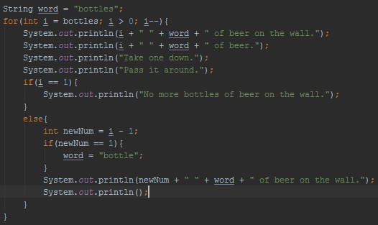
Activity
Now that we have the number of bottles of beer that are currently hanging on the wall we can create the main body of the song.

Slide 13

Activity
We now have now coded the song, now we just need to execute it.
Before we can do that though, we need to first create the ‘main’ method for the class and create a new instance of the class inside of the main method and then call the method we have created to sing our song.

Slide 14
Java Programming – Reference Data Types
Notes:
2 - Describe and communicate hazards associated with this lesson
Health & Safety
Check trailing cables
Identify any visible hazards
Store student bags safely
Enforce no drinking rule next to electrical equipment
No mobile phone use
Equality & Diversity
Identify learners with specific needs
Provide all learners with same level of support where appropriate.
Safeguarding
Every Child Matters and college procedures
Ensure all learners have consent forms in case of photo / video work

Slide 15
Reference Variables
Reference variables are used to store, would you have guessed it, a reference to another object.
We have already used reference variables within our code.
Reference variables are created by initialising a variable with an object as the data type, with a new instance of a class.
The data type of the variable must be of the same type as the class you are creating or a parent class of the class you are creating a new instance of.
Reference variables hold ‘Objects’.

Slide 16
Do you…
Know the different data types available within Java?
Know what type of data can be held in each data type?
Understand the importance of using not only correct data types, but also the most suitable data type?
Notes:
Teaching Strategies:
Exposition
Student Activities:
Listen
Make notes
Provide responses
Produce documentation to cover techniques covered so far during sessions – refer/update to eILP
Ongoing Assessment for Learning
Direct Questions
Students Discussion
Observations
Notes:
Learners make notes

